Slide 1
My Gratitude
My Responsibility

Slide 2
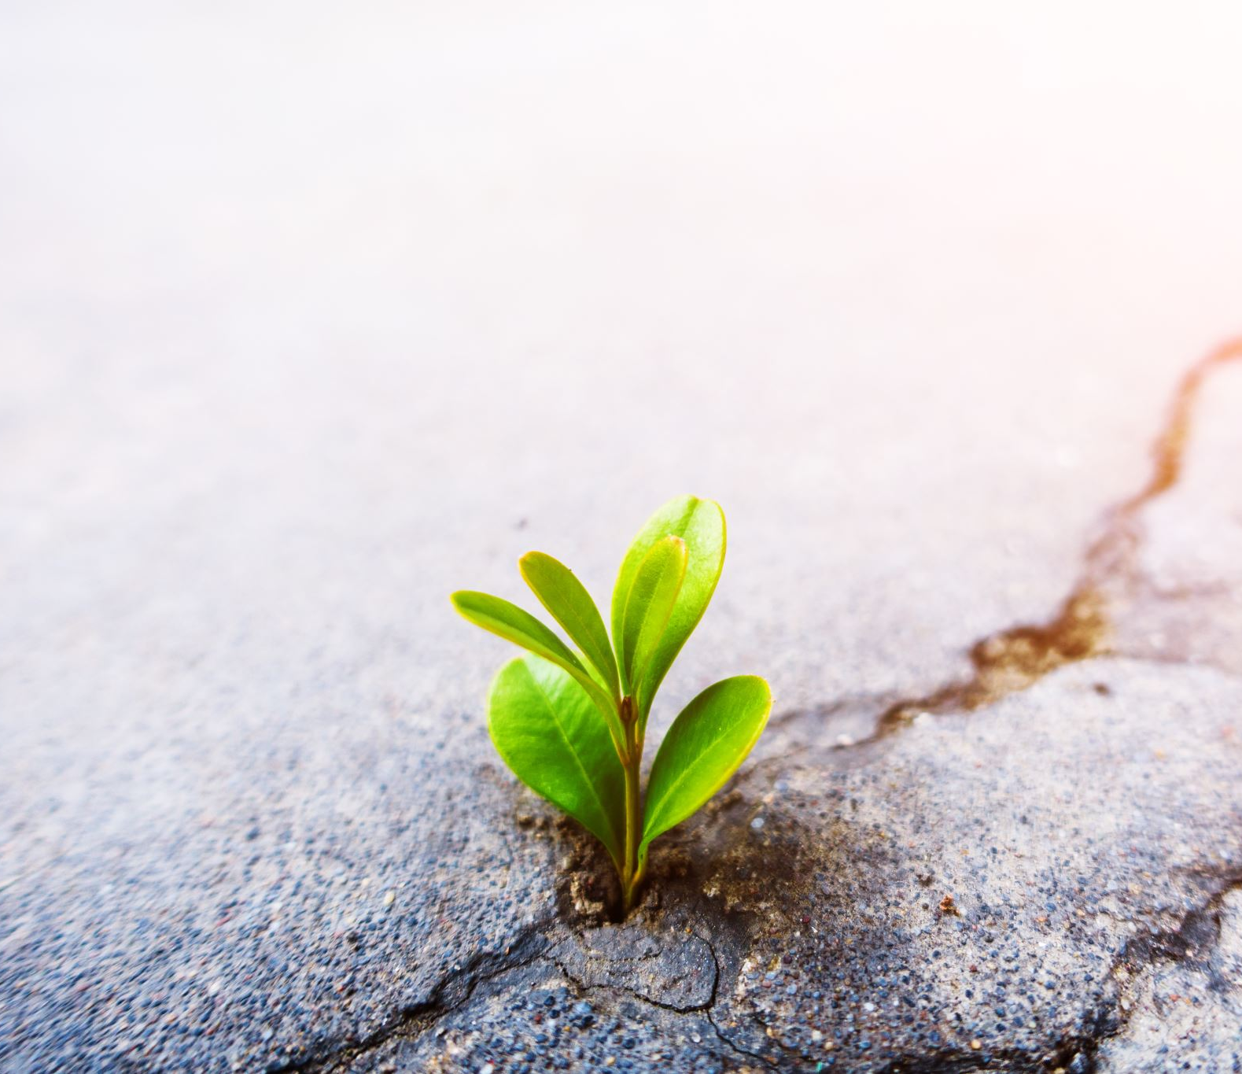
What is Gratitude?
What do I understand by ‘gratitude?’
What enables me to understand the concept of gratitude?
How can I understand the meaning of gratitude without the concept of ‘loss’?
How can I reflect on the ‘loss’ in my life to help me better understand the concept of gratitude and therefore appreciate even my ‘loss?’
Is gratitude relative?
Is gratitude finite or infinite?
How would gratitude exist without a world of ‘opposites?’, and how would we understand the concept of gratitude without being able to compare my blessings to those without, or having the ability to imagine a world without them? So How can this bring me to be more grateful of negative events that may have happened in my life?- Is the wisdom that can be gained from pain and loss not something I can be more grateful for?

Slide 3
Am I grateful?
Who am I? Who made me? Why am I who I am?
What is my purpose in my life?
What are my blessings? What gifts and talents do I have? Do I have any? Did I create everything in my life or was it created by that which is Higher than me? Am I self sufficient or am I dependent on a Higher Source for my provision?
How does my ability to see a glass as ‘half full’ rather than ‘half empty’ affect my ability to ‘see’ and appreciate my blessings? How does seeing my life as about ‘you’ rather than about ‘me’ help me see the glass as half full rather than half empty? How can unconditional love help me be more grateful?
Am I ‘grateful’ for my blessings? If so- how do I know this? How do I choose to, and how am I able to express my gratitude through my thought, speech and behavior? Do I use my blessings to help others?
Who am I grateful to for my blessings, gifts or talents and opportunities? Does the one that I show gratitude to deserve my gratitude? Is the One that I show gratitude to- the ultimate Source of my blessings? How can I elevate my gratitude to a place that is Higher than myself?
How can elevating my gratitude toward the Ultimate Source of my blessings help me achieve more inner peace?
Is my gratitude driven by my love, or by my ego? Am I grateful in order to feel better about myself or am I grateful in order to express my unconditional love for another?

Slide 4
Am I grateful?
What am I grateful for? Can I think of 5 blessings that I am most grateful for?
Am I grateful for being me? Or do I want to be that which I am not? Am I a static being or am I ever moving closer to becoming who I am?
Is that which I am most grateful for in my life- physical or non physical?
Is that which I am most grateful for in my life- Everlasting or temporary?
Does my gratitude depend more on my physical or spiritual blessings?
What is more precious to me?- Gold or wisdom? Material wealth or understanding? My house or my relationships? My belongings or what I can do with them? My status or my health? Who I am or what others think of me?
How can my gratitude for my spiritual blessings help me achieve a more permanent sense of wellbeing?
How can my gratitude for my physical blessings help me gain more spiritual blessings?

Slide 5
Why is gratitude important?
How does my gratitude help me? How does my gratitude affect my spiritual, emotional, physical and mental well-being?
How does my gratitude help my relationships with my Higher Being/Creator and with others in my life?
How does gratitude help me to take control over my evil inclinations?
How does gratitude influence my Faith?
How does my gratitude affect my ability to feel and express my peace, truth, love, compassion, patience, endurance, respect, humility, courage, integrity, peace, justice and forgiveness?
How does my gratitude help others?
How does my gratitude enable me to express my Love for my Creator and my fellow human being?

Slide 6
My Gratitude and my Spiritual wellbeing
Who am I? am I my body? Or am I my soul? Am I how I feel emotionally? Am I what I think? Am I what I do?
What do I understand by my ‘spiritual wellbeing’?
How do I feel in my ‘spirit’ when I feel grateful?
How do I feel when I feel ‘grateful’ in my heart when someone helps me? When I say ‘thank you’ to someone when they help me? How do I feel when I return a favor through my action to someone that has helped me in order to show them gratitude?
How does my gratitude towards others who show me kindness help ‘lift up’ my spirit and help me find inner peace?
How do I feel when I ‘take take take’ from others without giving back? How does it affect my sense of ‘purpose’ in my life? How does it affect my levels of depression and anxiety when I take more than I give?
Have I ever felt less inclined to accepting help from others because of my difficulty in expressing my gratitude to them? How does the ‘expectation of return’ of the kindness of others to me affect my ability to be grateful to them? How does this affect my spiritual sense of wellbeing?
How does my gratitude to my Creator- the Ultimate Source of my blessings help relieve me of the anxiety it causes me when I am unable to express my gratitude to others who help me?

Slide 7
My Gratitude and my physical wellbeing
How does my gratitude affect my energy levels? How do my energy levels affect my gratitude and my ability to express it?
How does gratitude affect my perception of physical ‘pain’?
How does my gratitude affect my ability to ‘endure’ the physical hardships and struggles that I face in my life?
How does my gratitude affect my ability to ‘sleep’ at night?
How does my gratitude affect the way that I ‘taste’ that which I drink and eat?
How does my gratitude affect my sense of ‘smell’?
How does my gratitude affect the way that I ‘see’ with my eyes? Do I see the world as more ‘colorful’ when I am more grateful? Am I grateful for my ability to see?
How does my gratitude affect my ability to ‘hear’ music with my ears? AM I grateful for my ability to hear?
How does my gratitude affect my ability to ‘feel’ the sweet ache of love in my heart? Am I grateful for my love?
How does my gratitude affect the way that I perceive the world around me and enjoy the sweetness of its fruit rather than lose myself in its bitterness?
How does my gratitude affect my ability to appreciate creativity and become more creative?
How can mindfulness help me to appreciate my physical blessings and help increase my levels of perception and awareness?

Slide 8
My Gratitude and my emotional/mental wellbeing
How does my level of gratitude affect my emotions? Can I think of some examples?
How does my emotional wellbeing affect my level of gratitude?
When was the last time I felt emotionally very down or anxious? What happened? Did I lose something that I believed was valuable to me? Did I feel as though I was a ‘victim’ of what happened? Did I complain because I felt that I deserved to have more than I have? Was I down because I lost control of the situation? Do I deserve to be in control of what happens to me? Am I grateful for the control that I have in my life? Am I the giver of my honor or is it given to me from that which is Higher than myself? How does my arrogance and sense of self worthiness affect my ability to show gratitude and therefore my emotional wellbeing?
How can changing my perspective of what is important in life ( ie. making my life more about ‘you’ rather than ‘me’- affect my ability to show and receive gratitude? How can this affect my emotional as well as spiritual physical and mental wellbeing?

Slide 9
My gratitude and my emotional/mental wellbeing
How does low self esteem affect my mood and level of anxiety? How does lack of purpose affect my level of self esteem? How can helping others with my blessings enable me to be more grateful and therefore increase my sense of purpose and self esteem thereby lifting my mood?
How does my gratitude affect my sense of self worth? Do I not feel more worthy of honor when I honor those who have less than I do? How can I show more gratitude by honoring those who have less than I do? How can I show more gratitude by sharing of my blessings to help others?
Do I become arrogant when I am given more blessings from above? Do I use my extra blessings ( beyond my needs) on satisfying and fulfilling my desires and use them to feed my evil inclinations? Or do I use the honor that I have been granted through my blessings to glorify the Source of my blessings and show gratitude for them by sharing with those who have less than I do?
Am I able to feel worthy of honor and remain humble at the same time? How can gratitude help me find the right balance between humility and confidence in self identity?

Slide 10
My gratitude and my emotional/ mental wellbeing
Do I spend today worrying about my future? If so- why? Am I able to ‘control’ what happens tomorrow? How does my anxiety which stems from the need to control my future affect my ability to be grateful for each and every moment of ‘now’ with each breath of life that I have been granted? How does it affect my ability to express gratitude for my blessings that I already have? How does it affect my ability to be creative? How can ‘surrendering’ to a cause that is Higher than me, help me to take more responsibility in my present moment and appreciate my blessings, thereby helping others?
Do I spend today despairing over what happened to me yesterday or in my past? If so- why? Am I able to change what happened? How can gratitude for the negative events that have happened in my life help me to ‘learn’ wisdom from them, and use that wisdom to help myself and others in the present moment and future? How can forgiveness and faith in a Higher Cause that is All Forgiving, enable me to ‘let go’ of my past mistakes, mend my ways and become more grateful?

Slide 11
My gratitude and my ego
How does my level of ‘ego’ affect my ability to be grateful?
How does my gratitude affect my sense of ‘ego’?
Do I show kindness in order to receive gratitude?
Do I show gratitude in order to feel ‘better’ about myself?
Is my gratitude driven by my ego or by my love for another?
Am I showing you gratitude for helping me- because I want you to feel better about yourself for the kindness you showed me- or is it so that I can feel better about myself for showing you gratitude?
Is my gratitude about me or you?
How can my gratitude about ‘you’ rather than ‘me’ help to free me from showing kindness without expectation for return? How can it help me to give and receive unconditional love?
How can I experience gratitude for ‘you’ without any relationship with another? Am I grateful for my relationship with my Creator and with my fellow human?
How can I show gratitude for my feeling of ‘ego’ by gaining wisdom from it and using that wisdom to help me become more grateful and attain unconditional love?

Slide 12
My gratitude and my greed
How does my gratitude affect my greed?
How does my greed affect my gratitude?
Am I able to be greedy and grateful at the same time?
If true altruistic gratitude is proportional to how much I share my blessings with those who have less than I do, without expectation of return- then how can I want more, while giving more at the same time? How can my gratitude through giving that which I love for myself, to help others, help to save me from my greed?
What do I ‘need’ in my life and why? What do I ‘want’ that is beyond my needs and why? How does my greed affect how I define my ‘needs’ and my ‘wants’ in life? How can gratitude help me to be more giving ( beyond my needs) while expecting less from others and this worldly life? How can my gratitude help me to become more charitable without feeling a sense of despair over my loss?
How can I show gratitude for my feeling of ‘greed’ by gaining wisdom from it and using that wisdom to help me become more grateful and attain unconditional love?

Slide 13
My gratitude and my envy
How does my gratitude affect my envy? Am I able to envy something or someone that I am grateful to?
How does my envy affect my gratitude? Am I able to show gratitude to someone or something that I envy?
Why do I envy others? Is it because they have more of something than I do? Is it because they do not share their blessings with me who has less and is more needy? Who or What is the Source of their provision? Should I like that others should envy me for having more than they have? Why should others give to me when I do not give to others? How can gratitude help me to become less envious of others? How can my envy teach me the importance of showing more gratitude through sharing with those who have less than I do?
How can my gratitude help me to overcome my feelings of envy so that I can improve my relationships with The Source of my blessings and with others? How can improving my relationships with my fellow human help me to become more grateful?
How can I show gratitude for my feeling of ‘envy’ by gaining wisdom from it and using that wisdom to help me become more grateful and attain unconditional love?

Slide 14
My gratitude and my lust
How does my gratitude affect my lust?
How does my lust affect my gratitude?
Can I be grateful and lustful at the same time? Am I lustful of that which I believe is forbidden for me? How can my gratitude help me to stay true to myself, and what I believe to be ‘right and wrong?’
How can my lust teach me how to become more grateful?
How can my gratitude help me to control my lust?
How can I show gratitude for my feeling of ‘lust’ by gaining wisdom from it and using that wisdom to help me become more grateful and attain unconditional love?

Slide 15
My gratitude and my sloth
How does my gratitude affect my sloth?
How does my sloth affect my gratitude?
How does my sloth prevent me from showing gratitude to the best of my potential? Is not showing gratitude through action better than showing it through speech? Is not showing gratitude through speech better than showing it only in my mind and heart?
Am I more or less likely to feel my sloth when I am more able to express my gratitude to the best of my potential? Does my ability to express gratitude not increase my sense of wellbeing and purpose in life? Do I not feel less sloth when I am being true to my purpose?
How can I show gratitude for my feeling of ‘sloth’ by gaining wisdom from it and using that wisdom to help me become more grateful and attain unconditional love?

Slide 16
My gratitude and my anger
How does my gratitude affect my anger? Do I feel more or less angry when I am grateful?
How does my anger affect my gratitude? Am I more or less able to express my gratitude when I am angry?
How can my gratitude help me to better control my anger and thereby help improve my relationship with my Creator and with others?
How can my gratitude help me to become less vengeful to those who have hurt me? How can my gratitude help me to show more mercy when I am able to punish? How can my gratitude therefore affect my own ability to receive mercy?
How can I show gratitude for my feeling of ‘anger ’ by gaining wisdom from it and using that wisdom to help me become more grateful and attain unconditional love?

Slide 17
My gratitude and my hatred
How does my gratitude affect my hatred towards myself and to others?
How does my hatred towards myself and to others affect my gratitude?
Am I able to hate and be grateful at the same time? Why would I want to show gratitude to the one that I hate? Is that which I hate not from the same Source that provided me with my blessings? If I hate that which stems from its Source, how can I love The Source of my blessings with a complete unconditional love? How can my gratitude reach its highest form of altruistic kindness without unconditional love for the Source of my blessings?
How can I show gratitude for my feeling of ‘hate’ by gaining wisdom from it and using that wisdom to help me become more grateful and attain unconditional love?

Slide 18
My relationship with my gratitude
Do I need my gratitude and does my gratitude need me?
Do I love my gratitude and does my gratitude love me?
Is That which I love most in need of my gratitude or am I in need of my gratitude in order to show my love for That which I love?
Do I love That to which I am grateful to? Does that which I love, love me when I am not grateful? Am I loved more when I am grateful? Is That which I love dependent on my gratitude in order for me to be loved back? Would I be grateful to that which I love even if I did not feel loved back? Is my love to That which I am grateful to –conditional or unconditional? Am I loved unconditionally? How can true altruistic gratitude help me to appreciate unconditional love?
Am I grateful for my gratitude? Does my Gratitude reflect itself back to me? How can my gratitude for gratitude help me to see gratitude in the kindnesses and blessings shown to me?
How can being One with My Gratitude help me to feel loved and express true love?

Slide 19
My gratitude and my relationships
How does my ability to feel and express gratitude affect my relationship with my partner?
How does my ability to feel and express gratitude affect my relationship with my children?
How does my ability to feel and express gratitude affect my relationship with my siblings?
How does my ability to feel and express gratitude affect my relationship with my friends?
How does my ability to feel and express gratitude affect my relationship with my neighbor?
How does my ability to feel and express gratitude affect my relationship with my fellow human being?
How does my ability to feel and express gratitude affect my relationship with my Creator?
How does my ability to feel and express gratitude affect my relationship with myself?
What is the purpose of my blessings for which I am grateful for- if I can not share it with others? How can I share my blessings with others without having a meaningful ‘relationship’ with them?
How can gratitude help me to better appreciate my relationships?
What is most important to me- my physical blessings or my relationships with those that I love and those who love me?
How does my ability to feel and express gratitude affect my relationship with my parents?

Slide 20
My gratitude and my relationships
What is the purpose of gratitude if I am Alone?
How can the concept of gratitude exist without another in my life?
Am I ever alone?
How can my gratitude help me feel less alone?
How can I better express my gratitude to those that I want to have a relationship with?

Slide 21
The gratitude of others towards me
How do I feel when others show me gratitude for my kindness? Do I show gratitude to others for their kindness to me?
Does my kindness depend on the ability of my recipient to show me gratitude? Does this not limit my kindness and ability to express gratitude?
Am I kind in order to receive gratitude? Or am I able to give without expectation of return?
How do I feel when others show me kindness and expect in return my gratitude?- What if I feel unable at the time to express my gratitude in the way that is expected? Is not the kindness of others to me a Higher kindness when others do not expect anything in return?
What makes me feel more loved unconditionally? When others show me kindness with expectation of gratitude or when they show me kindness without expectation of return from me?
Do I treat others how I myself would want to be treated?
How can achieve a Higher level of Peace and Purity by expecting no return for my kindness I do to others? Am I able to purely rely on The Ultimate Source of Kindness and blessings, for return? Am I able to express kindness and gratitude in a way that is driven by unconditional love for my Creator and Source of blessings, as well as my human fellow?

Slide 22
The purpose of my gratitude
What is the purpose of my gratitude?
Do I need gratitude to become a better person? Can it help me to gain better mastery over my evil inclinations so that I may improve my relationships with others? Can it directly improve my relationships with myself, others and The Source of my blessings? Can it help me to feel more at peace with myself and better control my emotions of sorrow and grief and anxiety?
We know that things could always be better? But how can meditating on my gratitude show me that things could always be worse?
What is the point of simply ‘feeling grateful?’- who does this benefit? What is the point of feeling grateful if I do not speak it? What is the point of speaking of my gratitude if I do not express in it my behavior?
What is the point of being grateful even in my deeds if it does not lead me to further growth and self development towards Peace and joy?

Slide 23
What can help me become more grateful?
Can I try to look at my glass as half full rather than half empty? How do I choose to use that which is in my cup? Is it for my own satisfaction, or can I use it to help others? Who will refill my empty cup? To what level will it be filled? Does this not depend on how I use what is remaining in my cup?
Is anything in this physical world perfect or everlasting?
Is not everything physical temporary and in constant need of repair and maintenance? Are there not always others who are in more need of our physical blessings than we are? If it wasn’t for them then how would we know gratitude? Are there not always others who have more than we are of physical blessings? If it wasn’t for us then how would they understand the concept of gratitude? Are we grateful to those who have less than us? How do we show them our gratitude? Can we show them gratitude by sharing our blessings with them ( That which is beyond our needs?)

Slide 24
What can help me become more grateful?
How does prayer and mediation help me focus on developing my gratitude?
How can I become more disciplined in prayer and meditation to help me count my blessings at regular intervals during my day?
Could I start the day by proclaiming thanks to my Creator and sustainer for Life, and for restoring my soul into my body? Can I perhaps aim to remember Him in all that I say and do in order to remind myself to be grateful in my daily activities?
How can giving to charity help me? How can giving of what I love to help those in need help me to be more grateful for my blessings? Is my gratitude to my Creator not best shown by my compassion and kindness to others? Will this not help to purify my heart and from my sins which weigh me down? Will He not make gratitude easier for the heart that follows its path regularly?

Slide 25
What can help me become more grateful?
How can I become more grateful through working on self development through reflection of :
My evil inclinations
My Faith
My compassion
My love
My respect
My humility
My forgiveness
My courage/strength/endurance
My Patience
My Truth
My Integrity
My Justice
Am I grateful for my ability to reflect on these concepts and use my blessings to help incorporate them into my own ways? Am I grateful for being Human?

Slide 26
Have I tried?
Establishing regular prayer for a time of meditation on my gratitude?
Establishing regular charity donations giving from that which is beyond my needs from my earnings to help the poor, needy, homeless, and to other charitable causes? And without expectation of return? In secret?
Have I tried fasting? How can fasting help me be more grateful?
Loving God with all my heart mind and soul and loving my fellow as myself in all that I do?
Reflecting on my past negative events/losses in order to gain wisdom from them and use this wisdom to help myself and others in the present and the future?
Using my gifts and talents and blessings that I have been given, and the opportunities that I have been granted by acknowledging that I am not the true source of my blessings, and that they do not belong to me but are on a loan- How can I be creative with my blessings to help others before the day comes that I lose them or they are taken back from me?

Slide 27
Who Should I be grateful to?
God? For His Everlasting Kindness and Love? The Source of Life and All existence? For providing us with the opportunity to ‘Be? To Become?’ For granting us the opportunity to have a ‘relationship’ with Him and all of Creation? For all that is beyond words and reason?
My Parents? For loving me, in ways that I may still never come to understand…
My teachers? For teaching me? Can I not learn from everything and anything using my senses and reason?
My Students? For giving me the opportunity to teach others? Can I not teach everything and anything around me for those who have ears and eyes and hearts?
My children? For allowing me to really ‘feel’ my sense of purpose in my life and give me the opportunity to express true love?
My friends? Who mourn with me when I mourn, and who provide a helping hand when I need? For giving me the opportunity to be a helping hand?
My Partner? Who gives and receives unconditional love? Who loves me for being me? Who accepts me the way I am? Who helps me become that which I am to become?
My evil inclinations? For leading me to paths from which I have found hidden wisdom? For teaching me about my imperfections and allowing me to turn back to my Creator, the Source of all that is Good?
My sorrows, my loss, and negative events, and hardships and trials that I have faced in my life? For showing me how to be more grateful? How to endure, how to better understand and appreciate Goodness? And for helping me to better appreciate the positive attributes of my soul?
How can my gratitude to God help me to further reach out with my kindness and show gratitude to Him through my kindness to those that I do not know but who can benefit from my kindness? How can my Faith and love for my Creator help me to reach the highest form of gratitude and kindness - by giving without expectation in return?
How could I ever be grateful enough for my blessings from Above?
Should I not be grateful for The Mercy from that which is Above me which allows me to have compassion on my inability to be grateful enough?

Slide 28
What am I more grateful for?
Me? Or You? How could I be me if you are not you? How could you be you if I am not me?
Light or darkness?
Unity or division?
Music or Silence?
Life or Death?
The Heat or The Shade?
Falsehood or Truth?
Folly or Wisdom?
Delusion or Reality?
Singularity or Pairs?
The Journey or the Destination?
The success or the failure?
Evil or Good?
Oneness or Infinity?
Destruction or Creativity?
The temporary or the Infinite?
The negative or the Positive?
The Sun or The Moon?
(The list of opposites can go on and on…)
Can I not find Peace in the Unity of the Pairs? How can one exist without the other?

Slide 29
All Praise and Thanks be to God- The Source of All Blessings, both direct and indirect.
To Him we Belong
To Him we return
(Without His Mercy we are nothing, for our gratitude alone cannot sustain us, unless it is infinite, non static, and united with His Everlasting unconditional Love.)
May we unite in seeking Truth and performing acts of loving kindness while respecting diversity, with humble sincere hearts…
Is it not the journey and the company which matters most? The destination can never be achieved alone…

